Slide 1
Arrays
Java Arrays

Slide 2
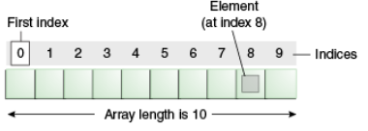
Java Array
Array is a collection of similar type of elements that have contiguous memory location
Java array is an object the contains elements of similar data type.
It is a data structure where we store similar elements. We can store only fixed set of elements in a java array.
Data structure: It’s the process storing data in particular order and particular way.
Array in java is index based, first element of the array is stored at 0 index.

Slide 3
Example
char c=65;
System.out.println(c);

Slide 4
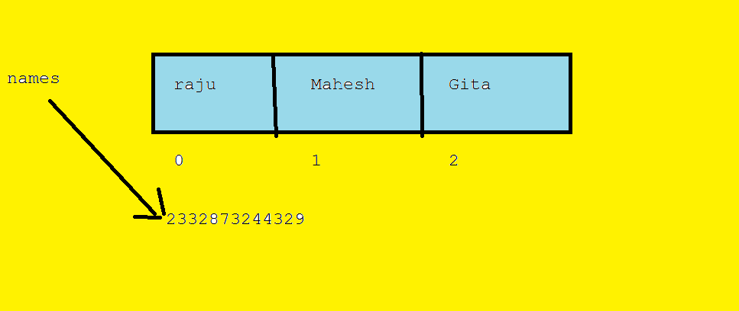
Memory allocation for Array
String names[] = {“raju”,”Mahesh”,”Gita”};

Slide 5
Advantage of Java Array
Code Optimization: It makes the code optimized, we can retrieve or sort the data easily.
Random access: We can get any data located at any index position.
It can store more than one value

Slide 6
Disadvantage of Java Array
Size Limit: We can store only fixed size of elements in the array. It doesn't grow its size at runtime.
It can’t store hetrogenious (different types of) elements
To solve this problem, collection framework is used in java.

Slide 7
Types of Array in java
Single Dimensional Array
Multidimensional Array

Slide 8
Single Dimensional Array in java
Syntax
dataType[] arr; (or)
dataType []arr; (or)
dataType arr[];
Example
int[] arr; (or)
int []arr; (or)
int arr[];

Slide 9
Preferred way
dataType[] arrayRefVar;

Slide 10
Array Creation
dataType[] arrayRefVar = new dataType[arraySize];
Alternative way
dataType[] arrayRefVar = {value0, value1, ..., valuek};

Slide 11
Instantiation of an Array in java
arrayRefVar=new datatype[size];
Ex
arr = new int[10];

Slide 12
Example of single dimensional java array
int a[] = new int[5];// declaration
a[0] = 10;// initialization
a[1] = 20;
a[2] = 70;
a[3] = 40;
a[4] = 50;
// printing array
for (int i = 0; i < a.length; i++)
// length is the property of array
System.out.println(a[i]);

Slide 13
Output
10
20
70
40
50

Slide 14
Declaration, and Initialization of Java Array
int a[]={33,3,4,5};//declaration, instantiation and initialization

Slide 15
Example
int a[] = { 33, 3, 4, 5 };// declaration, instantiation and initialization
// printing array
for (int i = 0; i < a.length; i++)
// length is the property of array
System.out.println(a[i]);

Slide 16
Output
33
3
4
5

Slide 17
Process Array with foreach Loop
double[] myList = { 1.9, 2.9, 3.4, 3.5 };
// Print all the array elements
for (double element : myList) {
System.out.println(element);
}

Slide 18
Output
1.9
2.9
3.4
3.5

Slide 19
Sort arrays with Arrays utility class
import java.util.Arrays;
public class ArraySort {
public static void main(String[] args) {
int[] nums = {40,30,20,50,10};
System.out.println("Before sorting");
for (int i : nums) {
System.out.print(i+" ");
}
Arrays.sort(nums);
System.out.println("\nAfter sorting");
for (int i : nums) {
System.out.print(i+" ");
} } }

Slide 20
Guess the output: null is added to the array
public class ArraySort {
public static void main(String[] args) {
String[] names = {"NTR","AMR",null,"KTR"};
Arrays.sort(names);
for (String name : names) {
System.out.print(name+" ");
}
}
}

Slide 21
Output
NullPointerException

Slide 22
Multidimensional arrays in java
Two Dimensional Arrays (Ex: int[][] arr)
Three Dimensional Arrays (Ex: int[][][] arr)
Four Dimensional Array(Ex: int[][][][] arr)
Etc…

Slide 23
Two Dimensional array in java
data is stored in row and column based index (also known as matrix form).
Syntax to Declare Multidimensional Array in java
dataType[][] arrayRefVar; (or)
dataType [][]arrayRefVar; (or)
dataType arrayRefVar[][]; (or)
dataType []arrayRefVar[];
Example
int[][] myArr(or)
int [][] myArr(or)
int myArr [][](or)
int []myArr[](or)

Slide 24
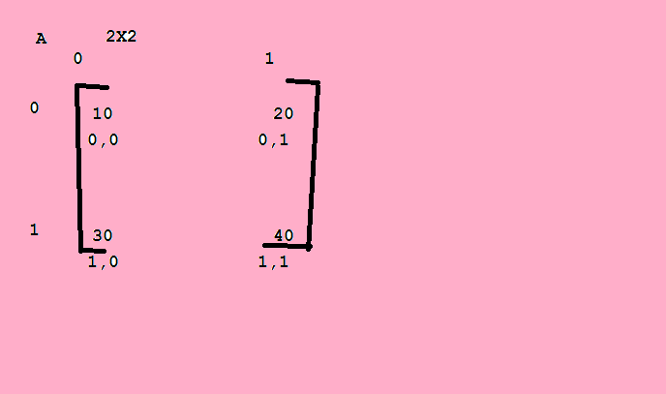
2X2 matrix

Slide 25
Example to instantiate Multidimensional Array in java
int[][] arr=new int[3][3];//3 row and 3 column

Slide 26
Example to initialize Multidimensional Array in java
arr[0][0]=1;
arr[0][1]=2;
arr[0][2]=3;
arr[1][0]=4;
arr[1][1]=5;
arr[1][2]=6;
arr[2][0]=7;
arr[2][1]=8;
arr[2][2]=9;

Slide 27
Example of Multidimensional java array
// declaring and initializing 2D array
int arr[][] = { { 1, 2, 3 }, { 2, 4, 5 }, { 4, 4, 5 } };
// printing 2D array
for (int i = 0; i < 3; i++) {
for (int j = 0; j < 3; j++) {
System.out.print(arr[i][j] + " ");
}
System.out.println();
}

Slide 28
Output
1 2 3
2 4 5
4 4 5

Slide 29
Addition of 2 matrices in java
// creating two matrices
int a[][] = { { 1, 3, 4 }, { 3, 4, 5 } };
int b[][] = { { 1, 3, 4 }, { 3, 4, 5 } };
// creating another matrix to store the sum of two matrices
int c[][] = new int[2][3];
// adding and printing addition of 2 matrices
for (int i = 0; i < 2; i++) {
for (int j = 0; j < 3; j++) {
c[i][j] = a[i][j] + b[i][j];
System.out.print(c[i][j] + " ");
}
System.out.println();// new line
}

Slide 30
Subtraction of 2 matrices in java
// creating two matrices
int a[][] = { { 1, 3, 4 }, { 3, 4, 5 } };
int b[][] = { { 1, 3, 4 }, { 3, 4, 5 } };
// creating another matrix to store the sum of two matrices
int c[][] = new int[2][3];
// adding and printing addition of 2 matrices
for (int i = 0; i < 2; i++) {
for (int j = 0; j < 3; j++) {
c[i][j] = a[i][j] - b[i][j];
System.out.print(c[i][j] + " ");
}
System.out.println();// new line
}

Slide 31
Product of Two matrices
int[][] a = {{10,20},{30,40}};
int[][] b = {{50,60},{70,80}};
int[][] c = new int[2][2];
for (int i = 0; i < a.length; i++) {
for (int j = 0; j < b.length; j++) {
for (int k = 0; k < c.length; k++) {
c[i][j]+=a[i][k]*b[k][j];
}
}
}
//result matrix
System.out.println("Multiplication of two matrices");
for (int i = 0; i < c.length; i++) {
for (int j = 0; j < c.length; j++) {
System.out.print(c[i][j]+"\t");
}
System.out.println();
}

Slide 32
Output
2 6 8
6 8 10

Slide 33
Three Dimensional Array represenation
int[][][] threedArray = new int[10][20][30];

Slide 34
Four Dimensional Array Example
int[][][][] fourdArray = new int[10][20][30][40];

Slide 35
Assignment
Write a program to find average of single dimensional array elements
Subtraction of two matrices
Product of two matrices

Slide 36
Quiz

Slide 37
Queries?

